Slide 1
Lecture-15

Slide 2
Contents
DevOps Release Stage
Continuous Integration using DevOps Tools
Jenkins
Jenkins Installation on Apache Tomcat
Setup plugins and Create jobs in Jenkins
Integrating Jenkins with GitHub, Ant, Junit
Create Deploy job
Create Complete Pipeline
CI / CD Build Pipeline

Slide 3
DevOps Release
In the realm of software engineering, a release is either a newly designed functionality or a recently modified piece of software.
Release management in software development and IT operations is a system for managing the entire software delivery lifecycle – from planning to building to testing to deployment.
In DevOps Deployment to an environment can be done by automation.

Slide 4
Continuous Integration
Continuous integration (CI) is the practice of automating the integration of code changes from multiple contributors into a single software project. It’s a primary DevOps best practice, allowing developers to frequently merge code changes into a central repository where builds and tests then run. Automated tools are used to assert the new code’s correctness before integration.

Slide 5
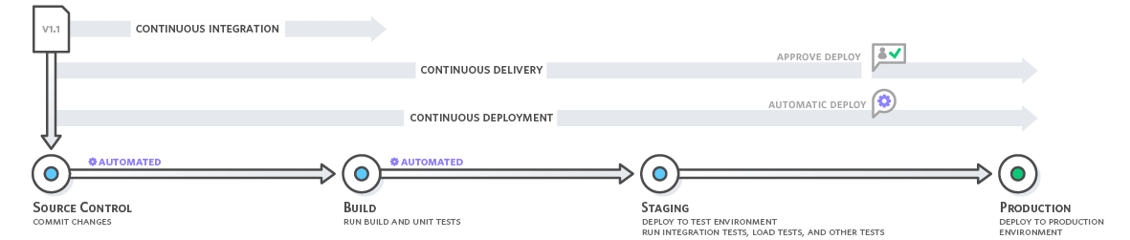
How does Continuous Integration Work?
Testing

Slide 6
Release Management Tools
Jenkins - popular tool for continuous integration but it can also be used for release management.
Ansible - this is an open source configuration management and application deployment tool intended for IT professionals.
Chef - another configuration management tool which enables continuous automation across all IT processes.

Slide 7

s
Jenkins - is an open source automation tool written in Java programming language that allows continuous integration.
It provides hundreds of plugins to support building, deploying and automating any project.
It is to automate all sorts of tasks related to building, testing, and delivering or deploying software.
Jenkins can be installed through native system packages, Docker, or even run standalone by any machine with a Java Runtime Environment (JRE) installed.

Slide 8
Jenkins Advantages
It is an open source tool.
It is free of cost.
It does not require additional installations or components. Means it is easy to install.
Easily configurable.
It supports 1000 or more plugins to ease your work. If a plugin does not exist, you can write the script for it and share with community.

Slide 9
Jenkins Advantages (Cont.)
It is built in java and hence it is portable.
It is platform independent. It is available for all platforms and different operating systems. Like OS X, Windows or Linux.
Easy support, since it open source and widely used.
Jenkins also supports cloud based architecture so that we can deploy Jenkins in cloud based platforms.

Slide 10
Jenkins Disadvantages
Its interface is out dated and not user friendly compared to current user interface trends.
Not easy to maintain it because it runs on a server and requires some skills as server administrator to monitor its activity.
CI regularly breaks due to some small setting changes. CI will be paused and therefore requires some developer's team attention.

Slide 11
Jenkins Architecture
Jenkins follows Master-Slave architecture to manage distributed builds. In this architecture, slave and master communicate through TCP/IP protocol.
Jenkins architecture has two components:
  Jenkins Master/Server
  Jenkins Slave/Node/Build Server

Slide 12
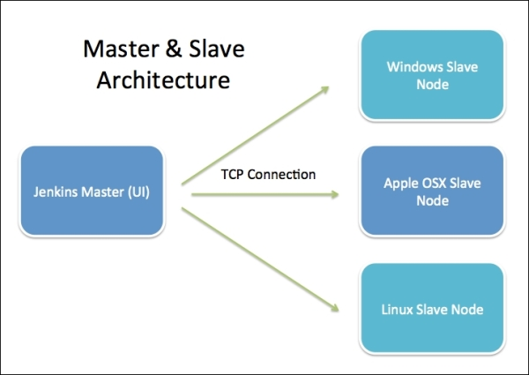
Jenkins Architecture (Cont.)

Slide 13
Jenkins Master
The main server of Jenkins is the Jenkins Master. It is a web dashboard which is nothing but powered from a war file. By default it runs on 8080 port. With the help of Dashboard, we can configure the jobs/projects but the build takes place in Nodes/Slave. By default one node (slave) is configured and running in Jenkins server. We can add more nodes using IP address, user name and password using the ssh, jnlp or webstart methods.

Slide 14
Jenkins Master (Cont.)
Scheduling build jobs.
Dispatching builds to the nodes/slaves for the actual execution.
Monitor the nodes/slaves (possibly taking them online and offline as required).
Recording and presenting the build results.
A Master/Server instance of Jenkins can also execute build jobs directly.

Slide 15
Jenkins Slave
Jenkins slave is used to execute the build jobs dispatched by the master. We can configure a project to always run on a particular slave machine, or particular type of slave machine, or simple let the Jenkins to pick the next available slave/node.
As we know Jenkins is developed using Java is platform independent thus Jenkins Master/Servers and Slave/nodes can be configured in any servers including Linux, Windows, and Mac.

Slide 16
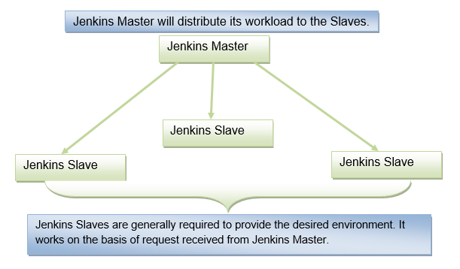
Jenkins Slave (Cont.)
It consists of a Jenkins Master which is managing three Jenkins Slaves.

Slide 17
Installing Jenkins on Windows
Hardware Requirements
Software Requirements
Memory | 2 GB RAM (Recommended)
Disk Space | We need at least 1 GB of space in our hard drive for Jenkins
JDK | We need either Java Development (JDK) or Java Runtime Environment (JRE)
Operating System | Jenkins can be installed on Windows, Mac OS X
Java Container | The WAR (Web Application Resource) file can be run in any container that supports Servlet 2.4/JSP 2.0 or later. (For example Tomcat 5).

Slide 18
Jenkins Release Types
Long term support release (LTS): Long-term support releases (LTS) are available every 12 weeks. They are stable and are widely used and tested. Basically, this release is intended for end users.
Weekly release: This release is available in every week by fixing bugs in its earlier version. These releases are intended towards plugin developers.

Slide 19
Java and Tomcat Setup for Jenkins
Java Setup
  Install Java JDK
    https://www.oracle.com/java/technologies/javase/jdk17-archive-downloads.html
  Configure the environment variables
    User Variable
    System Variables (bin)
  Once the java has been installed properly on your system and Java environment variable has been set, then you can verify it by using the following commands:
    C:\ echo %JAVA_HOME%
    C:\ javac -version
    C:\ java -version

Slide 20
Java and Tomcat Setup for Jenkins (Cont.)
Download and Setup Tomcat
  The official website to download the tomcat is http://tomcat.apache.org/
  Go to the "Binary Distributions" section and download the file according to your platform.
  To download the latest version of tomcat and install.
  OR
  Install xampp-windows-x64-8.1.2-0-VS16-installer with Tomcat tools.
  Start tomcat services
  Now in browser open http://localhost:8080/
  Click on Manager App and set user/password

Slide 21
Jenkins and Tomcat Setup
Download Jenkins {Generic Java package (.war)}
  https://www.jenkins.io/download/
  https://get.jenkins.io/war-stable/2.332.3/jenkins.war
  Copy the downloaded Jenkins.war file and copy it to the C:\xampp\tomcat\webapps folder of the tomcat directory.
  Click on start button to start Jenkins
  Now, open the browser and go the link
    http://localhost:8080/Jenkins

Slide 22
Jenkins and Tomcat Setup (Cont.)
Now create directory in C:/JENKINSHOME
Set environment variables path in System Variable

Slide 23
Setup plugins and create jobs in Jenkins
Create jobs in Jenkins
GitHub - Code, Plug-in (Git and Github Plugin), Poll SCM
Ant – Build, Plug-in(Ant and Warning Next Generation )
Junit - Test, Plug-in (Junit)
Deploy – Deploy
Create Devops Complete Pipeline to generate sample.war

Slide 24
Setup plugins and create jobs in Jenkins (Cont.)
In the Home screen of the Jenkins (Jenkins Dashboard) click on the Manage Jenkins option on the left hand side of the screen.

Slide 25
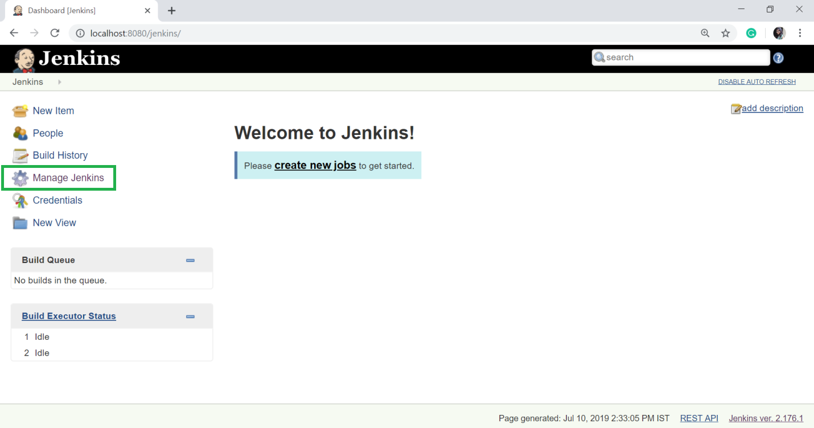
Setup plugins and Create jobs in Jenkins (Cont.)

Slide 26
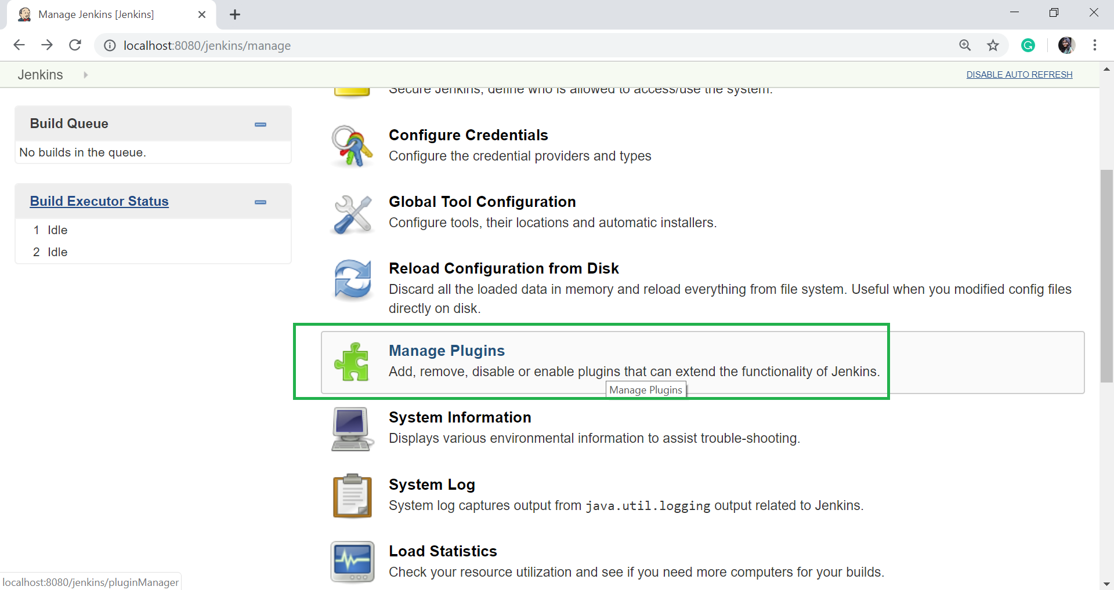
Setup plugins and Create jobs in Jenkins (Cont.)
Now, click on the Manage Plugins option.

Slide 27
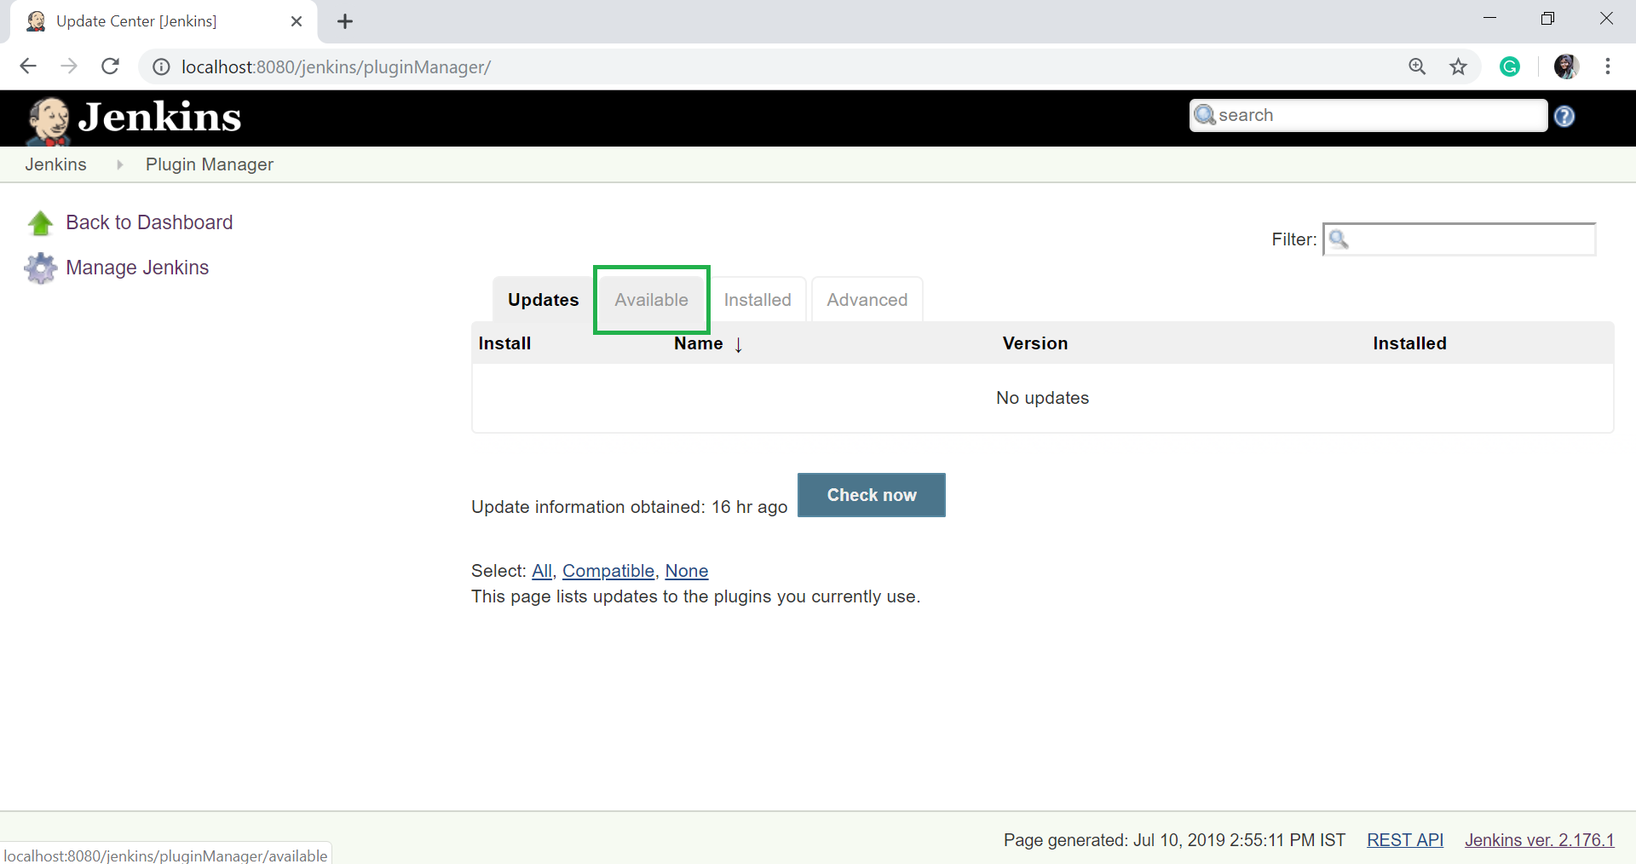
Setup plugins and Create jobs in Jenkins (Cont.)
In the next page, click on the "Available tab“

Slide 28
Setup plugins and Create jobs in Jenkins (Cont.)
The "Available" tab gives a list of plugins which are available for downloading. In the Filter tab type, type the "Git Plugin".
Select the GitHub and Git Plugin.
Click on the "install without restart". The plugin will take some time to finish downloading depending on your internet connection, and will be installed automatically.
You can also click on "Download now and install after restart" button in which the git plugin is installed after restart.
If you already have the Git plugin installed then go to "Installed" tab and in filter option type Git plugin.

Slide 29
Integrating Jenkins with GitHub
If you don't have Git installed in your system. To install the Git in your system, download the appropriate Git setup according to your operating system. I am installing for windows. Once the download is completed, install the Git.
Create directory in C:/> “gitworkspace”
Clone desired code repository from github.
https://github.com/sharifturi/JavaSampleWebApp.git

Slide 30
Integrating Jenkins with GitHub (Cont.)
Now Create GitHub Job
Let's see the process of integrating GitHub into Jenkins in a windows system.
  First create a new job in Jenkins, open the Jenkins Dashboard and click on "create new jobs".
  Click on “New Item”

Slide 31
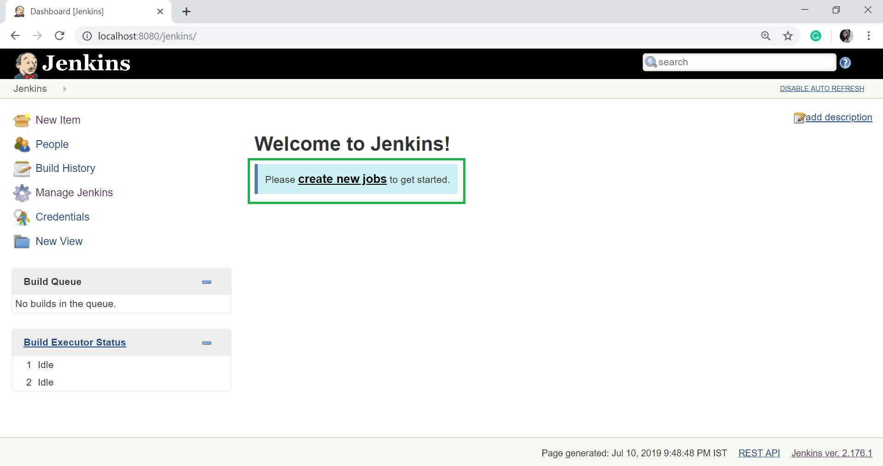
Integrating Jenkins with GitHub (Cont.)

Slide 32
Integrating Jenkins with GitHub (Cont.)
Now enter the item name and select the job type. For example, item name is ”githubpull” and job type is "Freestyle project".
Click on OK.
Once you click OK, the page will be redirected to its project configuration. Enter the project information.

Slide 33
Integrating Jenkins with GitHub (Cont.)
Now, under the "Source Code Management" you will see the Git option, if your Git plugin has been installed in Jenkins:
Click on Advance in General Tab and select Use Custom Workspace now enter:
  ${JENKINS_HOME}/workspace/SampleWebApp
Enter the Git repository URL on the "Repository URL" option to pull the code from GitHub.
  https://github.com/sharifturi/SampleWebApp.git
  Now Click on Apply and Save job

Slide 34
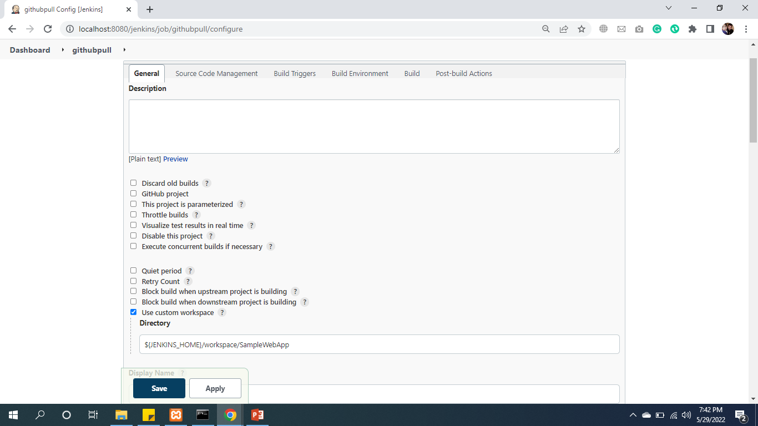
Integrating Jenkins with GitHub (Cont.)

Slide 35
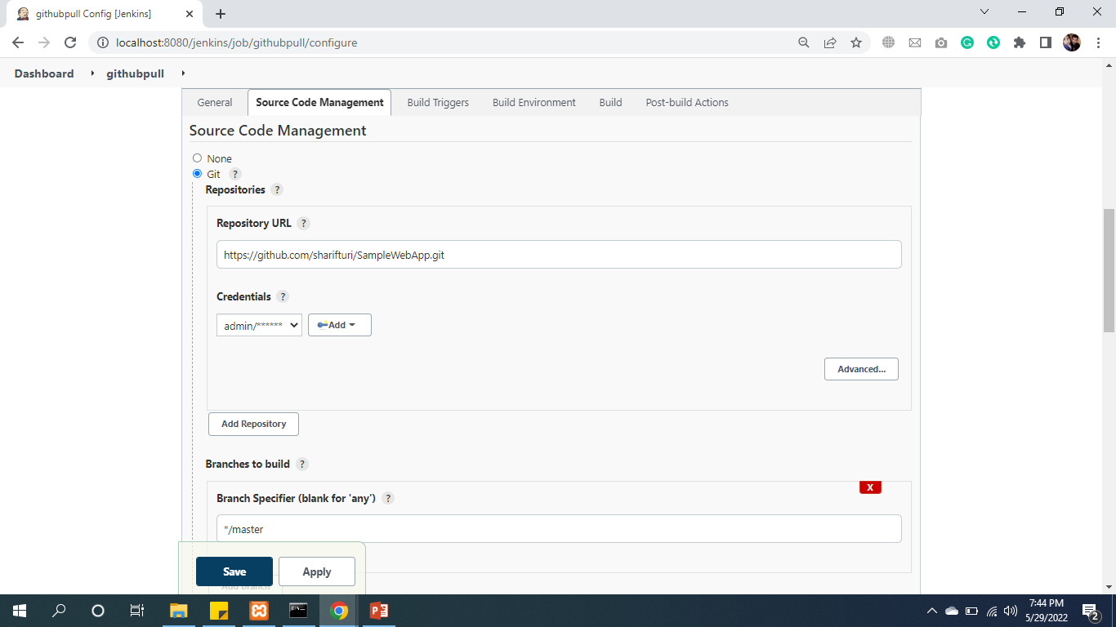
Integrating Jenkins with GitHub (Cont.)

Slide 36
Build Tool Ant
Apache Ant - (Another Neat Tool) is an open source project started by Apache Software Foundation and initially released on 19 July 2000.
Ant is a Java library and a software tool used for automate software build processes such as compile, run, test and assemble Java application.
It is a better alternate of Make build tool of Unix. Ant is written in Java and require JVM to build the Java projects.

Slide 37
Integrating Jenkins with Ant
Apache Ant - (Another Neat Tool) is an open source project started
Download archive: apache-ant-1.9.16-bin.zip
  https://ant.apache.org/bindownload.cgi
Create apache-ant-1.9.16 directory in C:/apache-ant-1.9.16 copy downloaded ant .zip file and extract it.
Set environment variables System Variables path of (C:\apache-ant-1.9.16\bin)

Slide 38
Create Build Job buildandcodereview Using Ant Tool (Cont.)
Now, click on the Manage Plugins option.

Slide 39
Create Build Job buildandcodereview Using Ant Tool (Cont.)
In the next page, click on the "Available tab“ search “Ant” and ”Warning Next Generation”

Slide 40
Create Build Job buildandcodereview Using Ant Tool

Slide 41
Install “Ant” and ”Warning Next Generation” Plugins

Slide 42
Create Build Job Ant Tool (Cont.)
The "Available" tab gives a list of plugins which are available for downloading. In the Filter tab type, type the " Ant and Warning Next Generation Plugin".
Select the “Ant” and ”Warning Next Generation” Plugin one by one.
Click on the "install without restart". The plugin will take some time to finish downloading depending on your internet connection, and will be installed automatically.
You can also click on "Download now and install after restart" button in which the “Ant” and ”Warning Next Generation” plugin is installed after
Now restart Tomcat and Jenkins.

Slide 43
Create unittest Job
After Testing required plugins installation
Create Unittest job

Slide 44
Unite-Test Tool (Junit)
JUnit is a unit testing framework for Java programming language.
It plays a crucial role test-driven development, and is a family of unit testing frameworks collectively known as xUnit.
JUnit promotes the idea of "first testing then coding", which emphasizes on setting up the test data for a piece of code that can be tested first and then implemented.

Slide 45
Install “Junit” Plugin

Slide 46
Install “Junit” Plugin (Cont.)
Now, click on the Manage Plugins option.

Slide 47
Install “Junit” Plugin (Cont.)
Search Junit Real-time Reporter Plugin

Slide 48
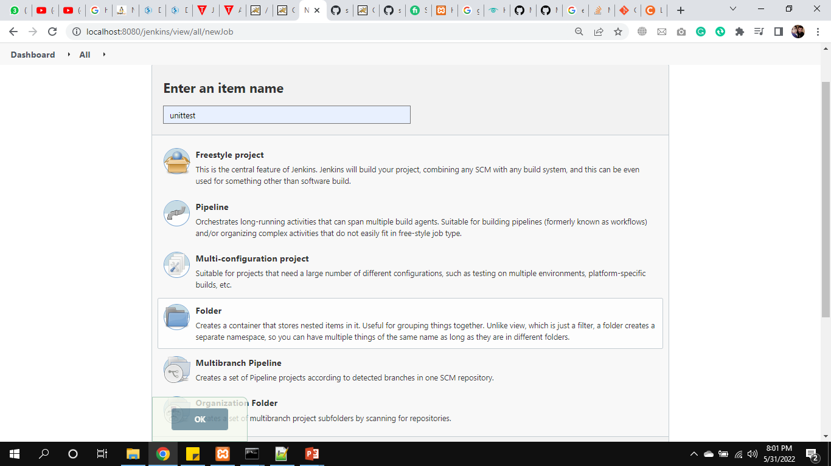
Create Job unittest Using JUnit Tool

Slide 49
Configure unittest

Slide 50
Configure unittest (Cont.)

Slide 51
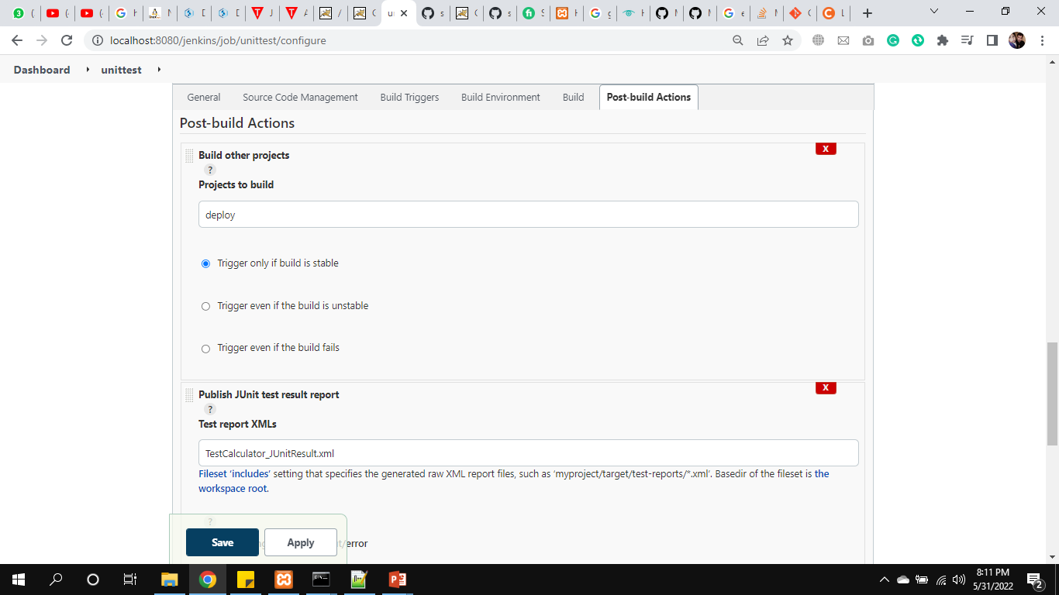
Configure unittest Post-Build-Action
Select and Set Publish JUnit test result report

Slide 52
Create Deploy job and Install Required Plugins
Deploy code to production
  Install Deploy to Container plugin
  Create new Job Deploy

Slide 53
Configure Deploy Job
Set Advance and git Description
  ${JENKINS_HOME}/workspace/SampleWebApp
  https://github.com/sharifturi/SampleWebApp.git
In Build to Invoke Ant set war
Post Build Action
  select Deploy war/ear to a container
  Type **/**war and samplewebapp
  In container ( select tomcat version) set Credentials

Slide 54
CI / CD Build Pipeline
In a Jenkins Pipeline, every job has some sort of dependency on at least one or more jobs or events.
A Jenkins Pipeline is a collection of jobs or events that brings the software from version control into the hands of the end users by using automation tools. It is used to incorporate continuous delivery in our software development workflow.
Code
Build
Test
Deploy on Sever / Container
1
2
3
4

Slide 55
Create complete pipeline
Install Build Pipeline Plugin
After it, to Configure all jobs
In Post-build Actions
githubpull
  Set build other projects
  Check on Poll SCM: if any changes or update the code the start auto.
  Set 5 (*****) to run pipeline after each one mints
  Set trigger schedule
  Set buildandcodereview to start automatic

Slide 56
Create complete pipeline (Cont.)
Buildandcodereview
  Set build other projects
  Set unittest to start automatic
Unittest:
  Set build other projects
  Set deploy to start automatic

Slide 57
Create complete pipeline (Cont.)
After configuration of all jobs create New view.
Click on (+) sign
Type name of view complete pipeline
Select Build Pipeline View
Click on Create

Slide 58
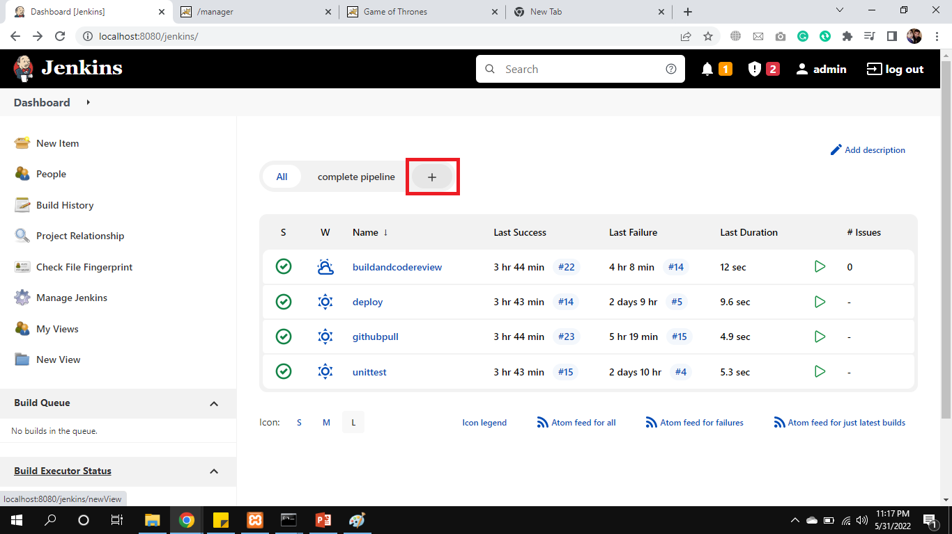
Create New view

Slide 59
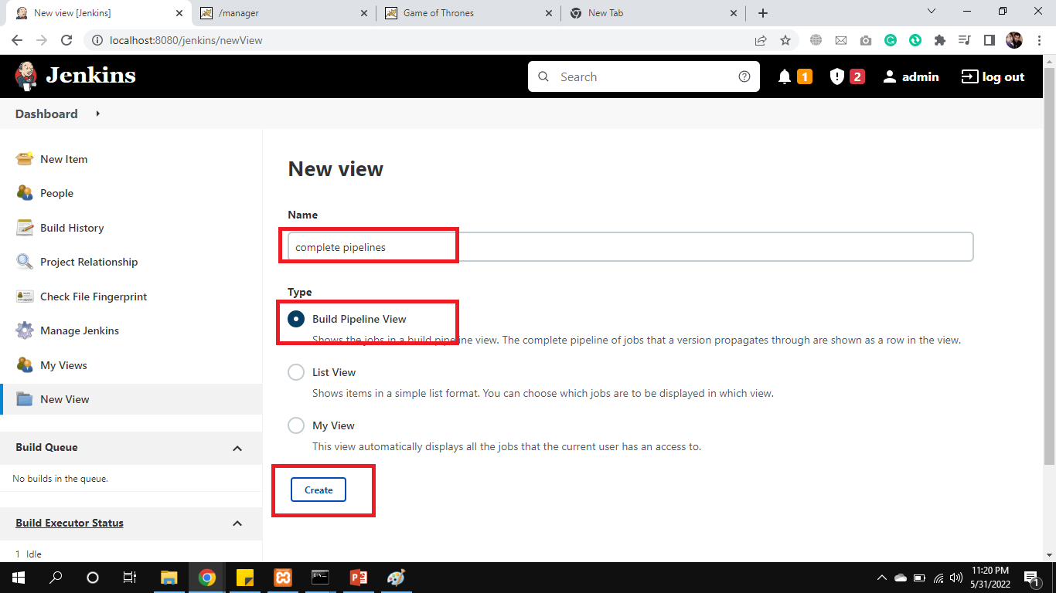
Create New view (Cont.)

Slide 60
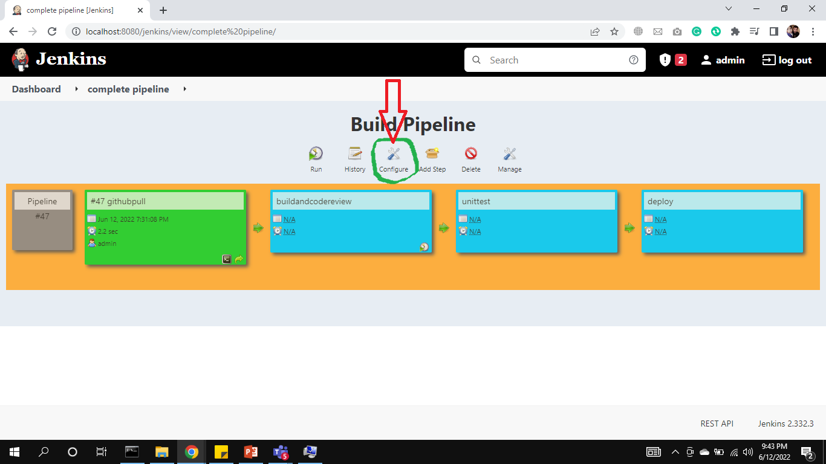
Build Pipeline Configuration
Click on Configure as mentioned in screenshot

Slide 61
Config Upstream / downstream
Select githubpull in Upstream / downstream config.
Click Ok

Slide 62
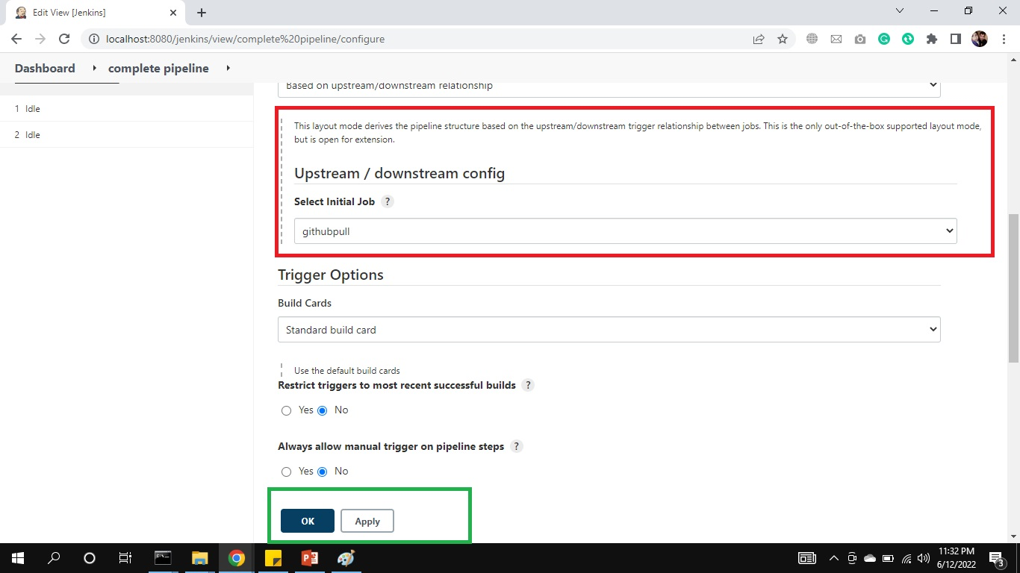
Create New view (Cont.)

Slide 63
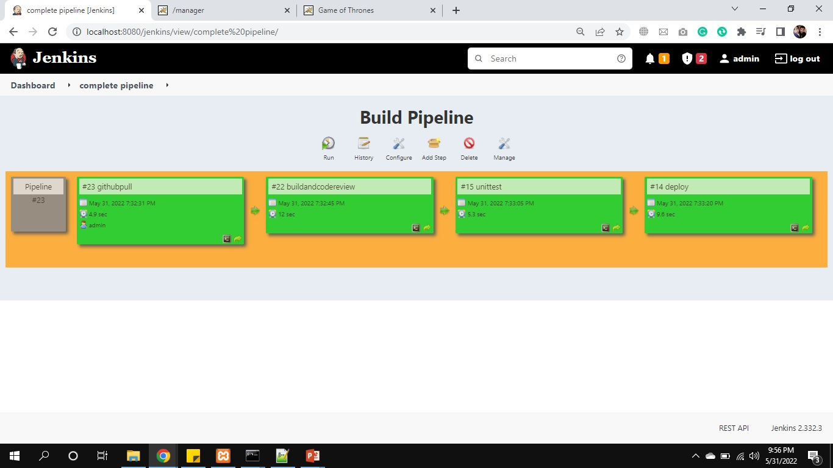
CI / CD Build Pipeline (Cont.)

Slide 64
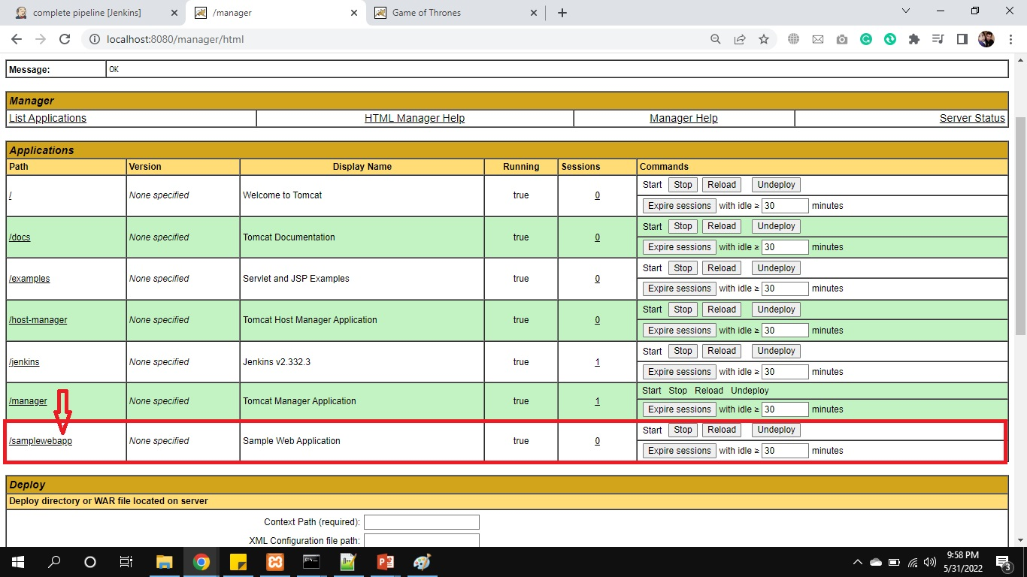
CI / CD Build Pipeline (Cont.)
Finally our application deployed on Tomcat Server.

Slide 65
Thanks
…?

